Slide 1


Social Buzz – Data Analysis

Slide 2


Today's agenda
Project recap
Problem
The Analytics team
Process
Insights
Summary

Slide 3


Project Recap
Audit of big data practice, recommendations for IPO, analysis of popular content of Social Buzz

Slide 4


Problem
Every day over 100,000 pieces of content, ranging from text, images, videos and GIFs are posted..
This data is highly unstructured and requires extremely sophisticated and expensive technology to manage and maintain.
Analyze Social Buzz data to find 5 most popular categories of content

Slide 5



Andrew Fleming (Chief Technical Architect),
The Analytics team
Marcus Rompton (Senior Principal)
Nisha A K
Data Analyst

Slide 6

Process
1
Data Collection
2
Data Cleaning
3
Data Analysis
4
Visualize
5
Generate Insights

Slide 7


Insights
16
Unique Categories
Animal Category has highest reaction score
2021 May
has highest posts

Slide 10

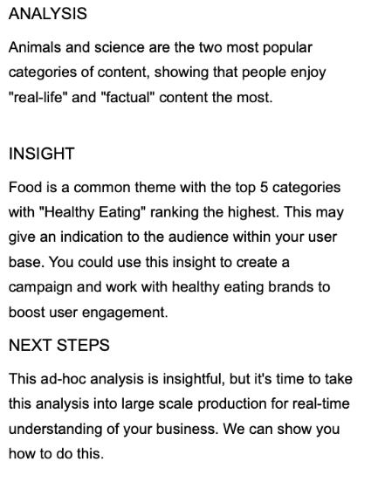

Summary

Slide 11

Thank you!
ANY QUESTIONS?

